Slide 1
Introduction to E-Commerce
TRUONG Quoc Dinh, PhD

Slide 3
Overview

Slide 4

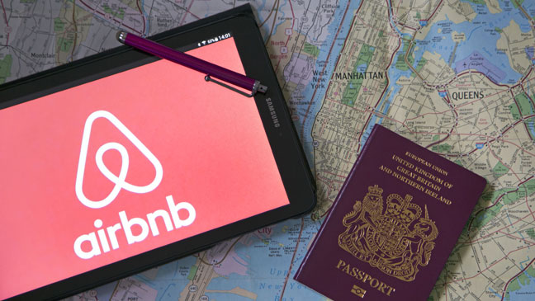
The Uber-ization of Everything
Have you used on-demand service companies?
Are there any negative consequences to the increased use of on-demand services?

Slide 5
E-commerce Trends
Mobile platform rivals PC platform
Continued growth of cloud computing
Explosive growth in Big Data
Continued growth of user-generated content on social networks, blogs, wikis

Slide 6
Periods in the Development of E-commerce

Slide 7
What Is E-commerce?
Use of Internet and Web to transact business
More formally:
Digitally enabled commercial transactions between and among organizations and individuals.

Slide 8
E-commerce vs. E-business
E-business
Digital enabling of transactions and processes within a firm, involving information systems under firm’s control
Does not include commercial transactions involving an exchange of value across organizational boundaries.

Slide 10
Types of E-commerce
May be classified by technology or market relationship
Business-to-Consumer (B2C)
Business-to-Business (B2B)
Consumer-to-Consumer (C2C)
Social e-commerce
Mobile e-commerce (M-commerce)
Local e-commerce

Slide 11
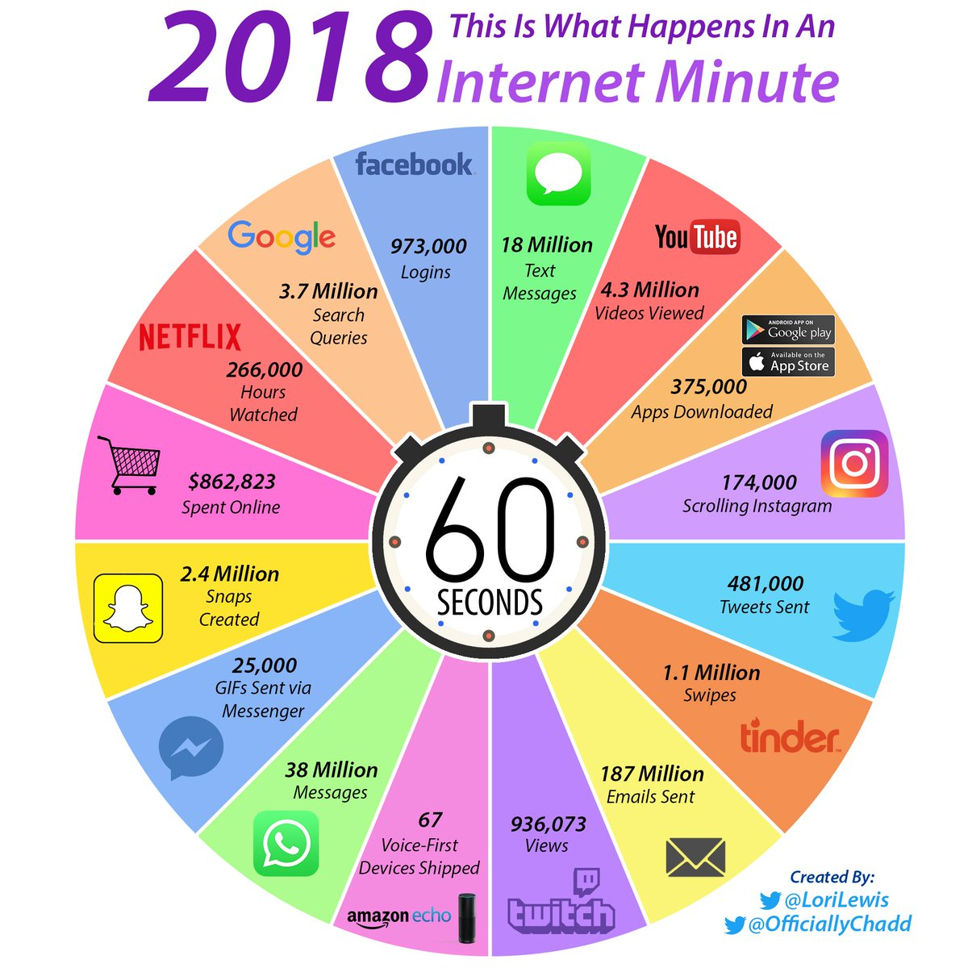

Slide 12
The Mobile Platform
Most recent development in Internet infrastructure
Enables access to the Internet via wireless networks or cell-phone service
Mobile devices include
Tablets
Smartphones
Ultra-lightweight laptops

Slide 14
Markets
Market = “place” to trade products and services
Information asymmetry in practice
Marketspace = online marketplace
Extends beyond temporal and geographic boundaries
Vision of a perfect market:
Perfect information
No participant with market power to set prices
No barriers to entry or exit
Equal access to production technology

Slide 15
Major Components in Marketspace
Consumers: individuals and organizations
Sellers: businesses that sell products/services online
Products and services: physical or digital goods, information
Infrastructure: technological foundations
Front-end: seller’s site, electronic catalogs, shopping cart, search engine, payment gateway
Back-end: activities related to order aggregation and fulfillment, inventory control, purchasing from suppliers, accounting, finance, payment processing, packaging, delivery
Intermediaries: third parties that operate between buyers and sellers
Other business partners: e.g., stakeholders, firm with different skills
Other support services: certification and ensure security to content providers

Slide 16
Unique Features of E-commerce Technology
Ubiquity
Global reach
Universal standards
Information richness
Interactivity
Information density
Personalization/customization
Social technology

Slide 19
New Considerations
Lower transaction costs – less time/money to shop online
Reach
Potential market is the entire online population
Traditional commerce must tradeoff between reach and richness
Broadcast model (e.g. newspapers)
EC has potential to personalize marketing to broad audience (e.g. agents)
Lower market entry costs = cost merchants must pay just to bring goods to a market
Lower search costs – easier to “window shop” and compare
Increase in information density = total amount of quality info available to all market participants
Price discovery and price transparency
Disintermediation = removing the “middle man”

Slide 20
Advantages
For sellers:
Increase sales opportunities
Operate 24/7 from virtual marketplace
No geographic restriction
Access to global markets
Increased speed and accuracy of information exchange
No barriers to entry
For buyers:
Wider choice selection
Shop 24/7
Instant access to detailed product information
Easy to compare prices
Quick delivery of digital products

Slide 21
Disadvantages
For sellers:
Rapidly changing technology
Insufficient telecommunications capacity
Difficulty integrating business systems with e-business software
Increased problems with security
Global market issues: language, policies/legal issues, currency
Increased competition
For buyers:
Concern over security
Lack of trust with unfamiliar sellers
Inability to touch/feel products
Resistance to unfamiliar buying processes

Slide 22
Comparison with Traditional Commerce
EC do at least the following electronically…
Contact between consumer and seller
Advertising
Billing

Slide 23
Predictions for the Future
Technology will propagate through all commercial activity
Large, traditional companies will continue to play dominant role, consolidating audiences
Start-up ventures can still attract large audiences in non-dominated arenas
Integrated online/offline companies will experience more growth than purely online companies

Slide 24
Interests from Diverse Fields
Computer science
Management science
Information systems
Economics
Marketing
Management
Finance/accounting
Sociology/psychology
Law

Slide 25
E-Commerce Infrastructure

Slide 26
The Internet
Worldwide Web (WWW) network of computer networks built on common standards
Created in late 1960s
Services include the Web, e-mail, file transfers, and so on
Can measure growth by number of Internet hosts with domain names

Slide 27
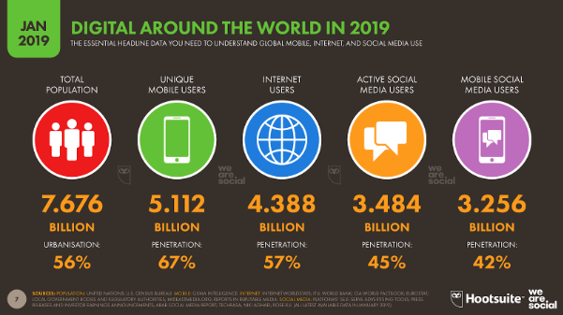

Slide 28
The Internet and the Evolution of Corporate Computing

Slide 29
The New Client: The Mobile Platform
In a few years, primary Internet access will be through:
Tablets
Supplementing PCs for mobile situations
Smartphones
Disruptive technology:
Shift in processors, operating systems
33% of all cell phones

Slide 30
The Web
Most popular Internet service
Developed in early 1990s
Provides access to Web pages
HTML documents that may include text, graphics, animations, music, videos
Web content has grown exponentially
Google reports 30 trillion unique URLs; 120 billion Web pages indexed

Slide 31
Web 1.0 - Web 2.0 - Web 3.0
Web 1.0 = display simple pages, allow non-linear navigation
Web 2.0 = user-centered applications and social media technologies
User-generated content and communication
Highly interactive, social communities
Large audiences; yet mostly unproven business models
Examples: Twitter, YouTube, Instagram, Wikipedia, Tumblr
Web 3.0 = Semantic Web = The Intelligent Web = Internet of Things
Convergence of several emerging technology trends: Ubiquitous Connectivity (i.e. mobile devices); Network Computing (SaaS); Open Technologies (i.e. open API’s, open data, open source); Open Identity (i.e. portable identity and personal data)

Slide 32
Web Browsers
A software program used to locate and display Web pages
Includes text, graphics, and multimedia content

Slide 33
Web Servers and Web Clients
Web server = software that enables computer to deliver web pages to client computers on a network
Hypertext transfer protocol (HTTP) = protocol for requesting web pages
Hypertext mark-up language (HTML) = language for writing web pages
Web client sends HTTP requests and displays HTML pages
Additional services provided by web servers
Security – authenticates site access
File transfer protocol (FTP) – transfers files to/from server
Search engine – indexes and facilitates searches within site
Data capture – monitors site traffic

Slide 34
Web Addresses & Domains

Slide 35
Web 2.0 Features and Services
Online Social Networks
Services that support communication among networks of friends, peers
Blogs
Personal Web page of chronological entries
Really Simple Syndication (RSS)
Program that allows users to have digital content automatically sent to their computers over the Internet

Slide 36
Web 2.0 Features and Services
Podcasting
Audio presentation stored as an audio file and available for download from Web
Wikis
Allows user to easily add and edit content on Web page
Music and video services
Online video viewing
Digital video on demand

Slide 37
Web 2.0 Features and Services
Internet telephony (VoIP)
Voice over Internet Protocol (VoIP) uses Internet to transmit voice communication
Video conferencing, video chatting, and telepresence
Online software and Web services
Web apps, widgets, and gadgets
Software that interacts with the user through voice commands
Natural language; conversational interface
Situational awareness
Interpret voice commands to interact with various Web services
Examples: Siri, Google Now

Slide 38
The Future Internet – Web 3.0
The Internet2 Project
Consortium of 350+ institutions collaborating to facilitate revolutionary Internet technologies
Guaranteed service levels and lower error rates
Ability to purchase the right to move data through network at guaranteed speed in return for higher fee
Declining costs
The Internet of Things (IoT)
Objects connected via sensors/RFID to the Internet
8 ways the Internet of things will change the way we live and work
16 Stunning Statistics that Forecast the Future of the Internet of Things

